Slide 1
Literary Analysis and Interpretation
Spanish - Foreign Language
Here is where your presentation begins

Slide 2
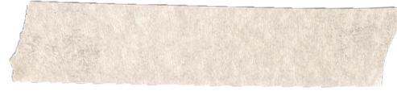
Contents of this template
You can delete this slide when you’re done editing the presentation
Fonts | To view this template correctly in PowerPoint, download and install the fonts we used
Used and alternative resources | An assortment of graphic resources that are suitable for use in this presentation
Thanks slide | You must keep it so that proper credits for our design are given
Colors | All the colors used in this presentation
Icons and infographic resources | These can be used in the template, and their size and color can be edited
Editable presentation theme | You can edit the master slides easily. For more info, click here
For more info: SLIDESGO | BLOG | FAQS
You can visit our sister projects: FREEPIK | FLATICON | STORYSET | WEPIK | VIDEVO

Slide 3

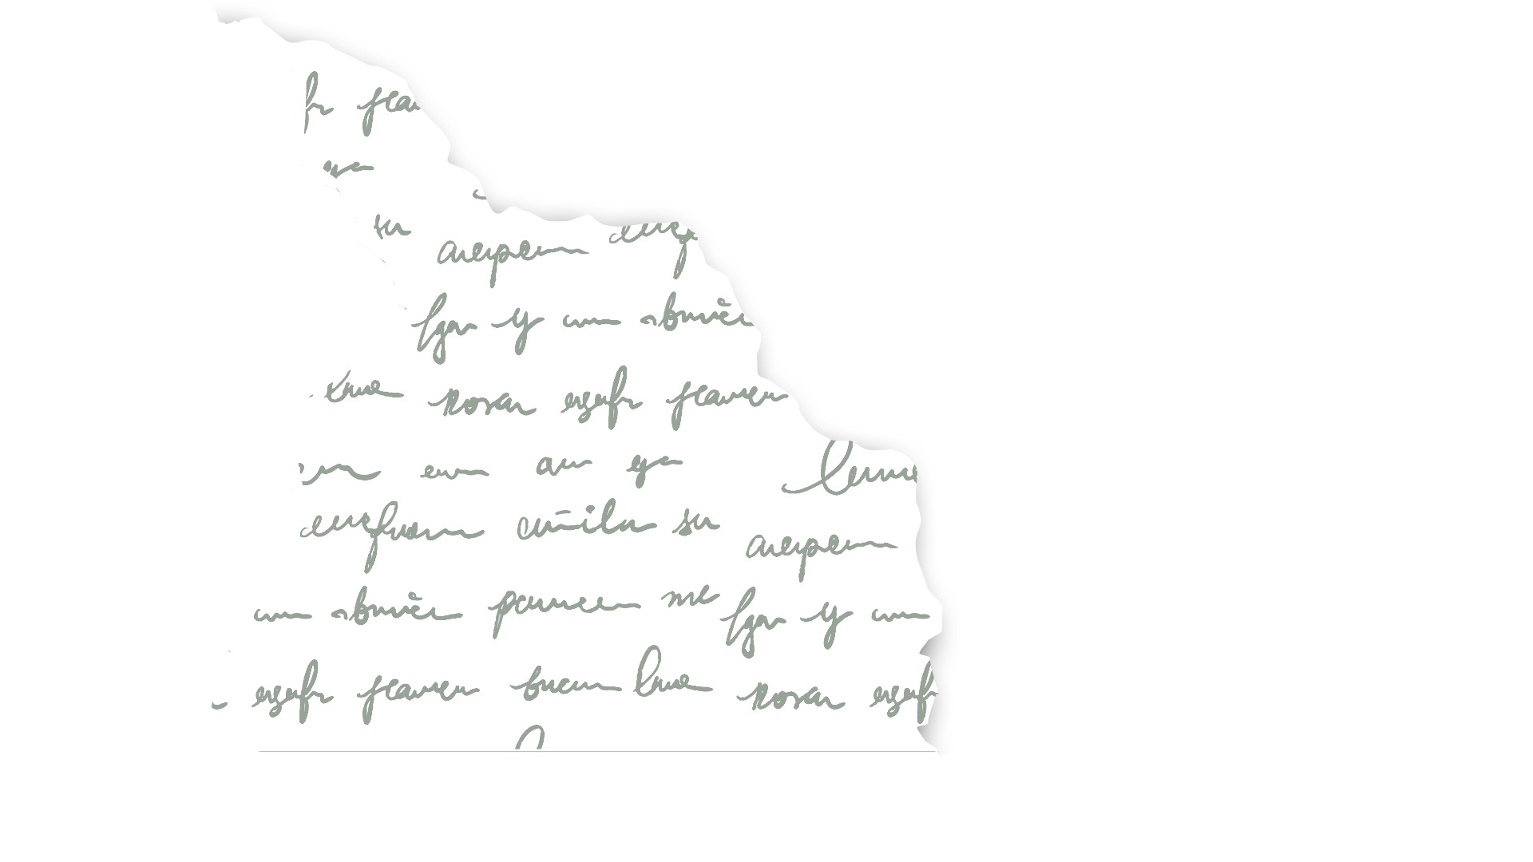
Table of contents
01
02
03
Introduction
You can describe the topic of the section here
Literary analysis
You can describe the topic of the section here
Literary interpretation
You can describe the topic of the section here

Slide 4
Whoa!
This can be the part of the presentation where you introduce yourself, write your email…

Slide 5
01
Introduction
You can enter a subtitle here in
case you need it

Slide 6
Introduction
You can give a brief description of the topic you want to talk about here. For example, if you want to talk about Mercury, you can say that it’s the smallest planet in the entire Solar System

Slide 7
About literature
Mercury is the closest planet to the Sun and the smallest one in the entire Solar System. This planet’s name has nothing to do with the liquid metal, since Mercury was named after the Roman messenger god. Despite being closer to the Sun than Venus, its temperatures aren’t as terribly hot. Its surface is quite similar to that of Earth’s Moon, which means there are craters
Speaking of craters, many of them were named after artists or authors who made significant contributions to their respective fields. Mercury takes a little more than 58 days to complete its rotation, so try to imagine how long days must be there! The temperatures on Mercury are extreme and the solar radiation is high, so the planet is uninhabitable

Slide 8
Basic tools for literary analysis
Style
Mercury is the closest planet to the Sun and the smallest one in the Solar System—it’s only a bit larger than the Moon
Structure
Venus has a beautiful name and is the second planet from the Sun. It’s hot and has a highly poisonous atmosphere

Slide 9
Literature elements
Plot
Mercury is the closest planet to the Sun and the smallest one in the Solar System
Characters
Venus has a beautiful name. It’s the second planet from the Sun and it’s hot
Environment
Despite being red, Mars is actually a cold place. It’s full of iron oxide dust

Slide 10
Literary plot structures
Exposition
Development
Jupiter is the biggest planet in the Solar System
Saturn is a gas giant and has several rings
Climax
Denouement
Despite being red, Mars is a cold place
Venus is the second planet from the Sun

Slide 11
Literary genres
Novel
Short story
Poetry
Mercury is the closest planet to the Sun
Venus is the second planet from the Sun
Despite being red, Mars is a cold place
Drama
Essay
Fantasy
Saturn is a gas giant and has several rings
Jupiter is the biggest planet in the Solar System
Neptune is the farthest planet from the Sun

Slide 12
—Someone Famous
“This is a quote, words full of wisdom that someone important said and that can inspire the reader”

Slide 13
An image reinforces
the concept
Images reveal large amounts of data, so remember: use an image instead of a long text. Your audience will appreciate it

Slide 14
Let's analyze Spanish poems
Read the poem and answer the questions on the right in your notebook
How would you describe the mood and setting the poem presents?
What is the effect of the words "silence" and "mystery"?
What do you think the flowers, sun and wind symbolize in this poem?
En el bosque de silencio y misterio, las sombras susurran en el hemisferio. Estrellas titilan con luz plateada, narrando historias de noche estrellada
Los suspiros del viento cuentan secretos, en este rincón donde los sueños son completos

Slide 15
Read and answer!
Read the following dramatic text and answer the corresponding questions (next slide)
Character A: (agitado) No puedo creer lo que acabo de escuchar. ¡Es una traición inaceptable!
Character B: (nervioso) Lo siento, no tenía otra opción. Fue una decisión difícil de tomar.
Character A: (enfadado) ¡Decisión difícil de tomar? ¡Esto cambia todo entre nosotros!
Character B : (apenado) No quiero que nuestras vidas se separen por esto. Por favor, intenta entender.
Character A: (frustrado) No sé si alguna vez podré perdonarte por esto. Nuestra confianza está rota.
Character B: (con tristeza) Siempre lamentaré el daño que esto causó. Solo espero que algún día puedas mirarme de nuevo.

Slide 16
Analyze a story!
Read the following text and answer the corresponding questions
En un bosque mágico, un zorro curioso encontró una llave dorada. Intrigado, decidió buscar la cerradura que encajara. Tras muchas aventuras, descubrió una antigua puerta en lo más profundo del bosque. Al girar la llave, descubrió un mundo lleno de maravillas y secretos
What is the fantastic element in this story and how does it affect?
What is the fox's goal in finding the key? What motivates him to look for the lock?
What aspect of the story did you find most intriguing or exciting and why?

Slide 17
Common literary genres in Spain
80%
60%
Novel
Poetry
Mercury is the closest planet to the Sun
Despite being red, Mars is a cold place

Slide 18
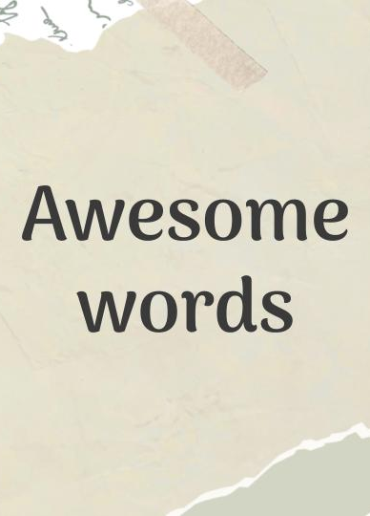
Tablet mockup
You can replace the image on the screen with your own work. Just right-click on it and select “Replace image”

Slide 19
Where is Spain?
Spain
Mercury is the closest planet to the Sun and the smallest one in the Solar System

Slide 20
Guess the literary genre!
According to the characteristics below, write the type of literary genre to which it refers
Literary genre
_______________
_______________
_______________
A long work
Multiple subplots
Psychological depth
Prose narrative
Metrical structure
Metaphor
Synthesis
Emotional
Dialogue and action
Staging
Structure in acts
Conflicts / tensions

Slide 21
Reflect on the text!
Read the following text and answer the corresponding questions
Who are the characters?
What is the plot?
How does it end?
Make a critical reflection
En la ciudad de sueños y luces encendidas, dos almas se cruzaron en noches compartidas. María, la artista, pintaba el cielo estrellado, Miguel, el músico, con su guitarra le cantaba
Cada pincelada y acorde unían sus caminos, tejiendo melodías en mágicos destinos. En un rincón bohemio, sus almas se entrelazaron, creando un universo donde sus sueños vibraron

Slide 22
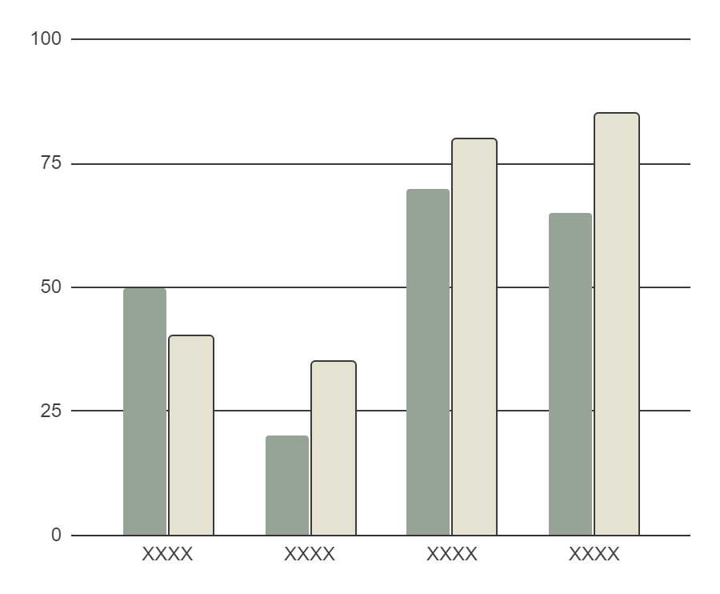
Spanish literature evolution
XXXX
XXXX
Venus is the second planet from the Sun
Mercury is the closest planet to the Sun
XXXX
XXXX
Despite being red, Mars is actually a cold place
Saturn is a gas giant and has several rings
Follow the link in the graph to modify its data and then paste the new one here. For more info, click here

Slide 23
Thanks!
Do you have any questions?
addyouremail@freepik.com +91 620 421 838 yourwebsite.com
Please, keep this slide for the attribution

